Slide 2
Through the Global Gender Gap Report, the World Economic Forum quantifies the magnitude of gender-based disparities and tracks their progress over time.
The Global Gender Gap Index seeks to measure the relative gaps between women and men across four key areas: health, education, economy and politics.

Slide 3
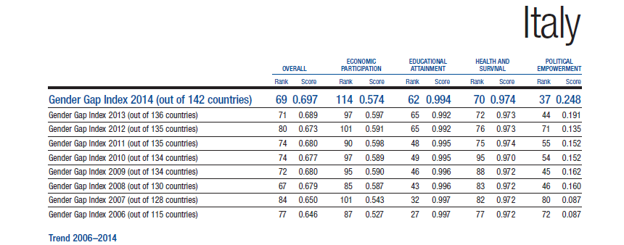

Slide 4
Training project on gender identity for teachers of 15 public kindergartens and preschools of Rome.
7 modules of Basic training (22 hours each)
8 modules of Additional training (14 hours each)
The project started in the school year 2013/2014 and continues this year.

Slide 5
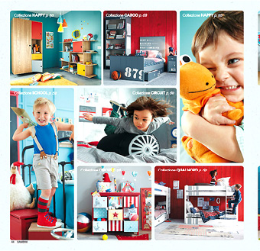
Decode behaviors, actions, practices, habits and expressions that convey or may convey models of identity and relationship stereotyped and stereotyping
Provide girls and boys a horizon as free and clear as possible, through which to build their identity and the relationship with the opposite sex and avoid discriminating logic.

Slide 6
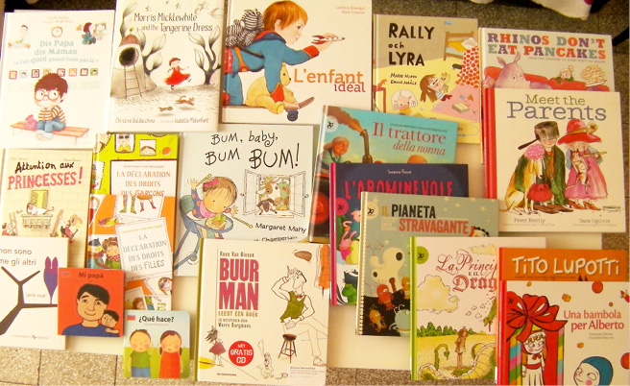
- Compensate for the structural training deficiencies of the Italian school system, with particular regard/reference to the construction of gender identity, the use of non-sexist language and the fight against discrimination, particularly for Kindergarten and preschools;
- Implement specific training activities that can support equality between women and men, the plurality of family models and sex roles, the fight against sexism; to pull for he fight against homophobia, bullying and violence against women.

Slide 7
- Provide education that is free and compulsory, affordable and accessible, especially
to families and children at risk;
Develop approaches that encourage the free and full expression of one's personality and that can induce both interest in and respect for cultural and individual differences;
Offer advice, counselling, relational and communication support to teachers and educators in the development of educational practices that can help stop the assumption of stereotypes.

Slide 8
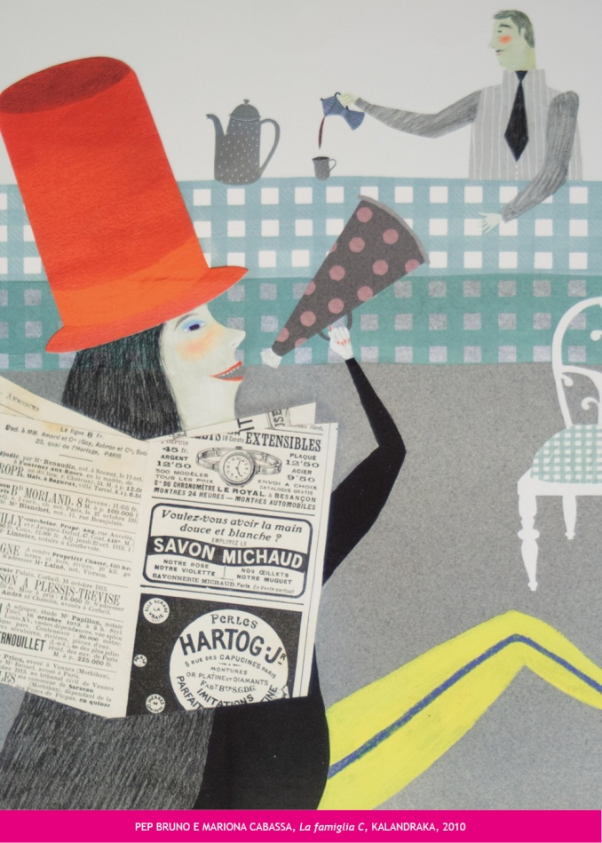
Tools used in our courses:
- Autobiographical narrative (both oral and written) of our participants;
- Listening activities and semi-structured observation of the classroom activities and the relationships among children;
- Shared proposal of project activities that could be carried out in the classrooms;
- A constant analysis and evaluation of our training program, both during and after the project, through an accurate monitoring process.

Slide 9
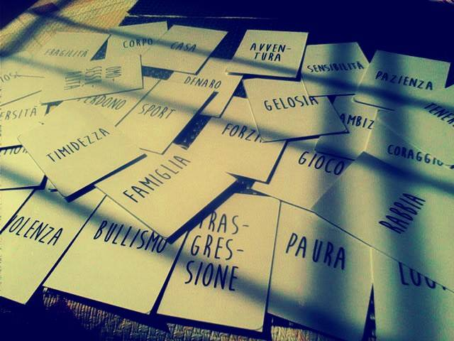
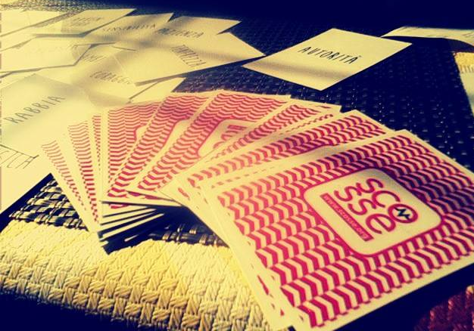

Slide 10
Reading without stereotypes is a bibliographic catalogue, available on the website www.scosse.org
Contents: childhood literature and picture books with stories and representations that encourage imagination, equal experiences and free life and professional choices.
It offers a vision on gender roles and identities free from stereotypes (in everyday activities, in relationships, within the family and society).

Slide 11
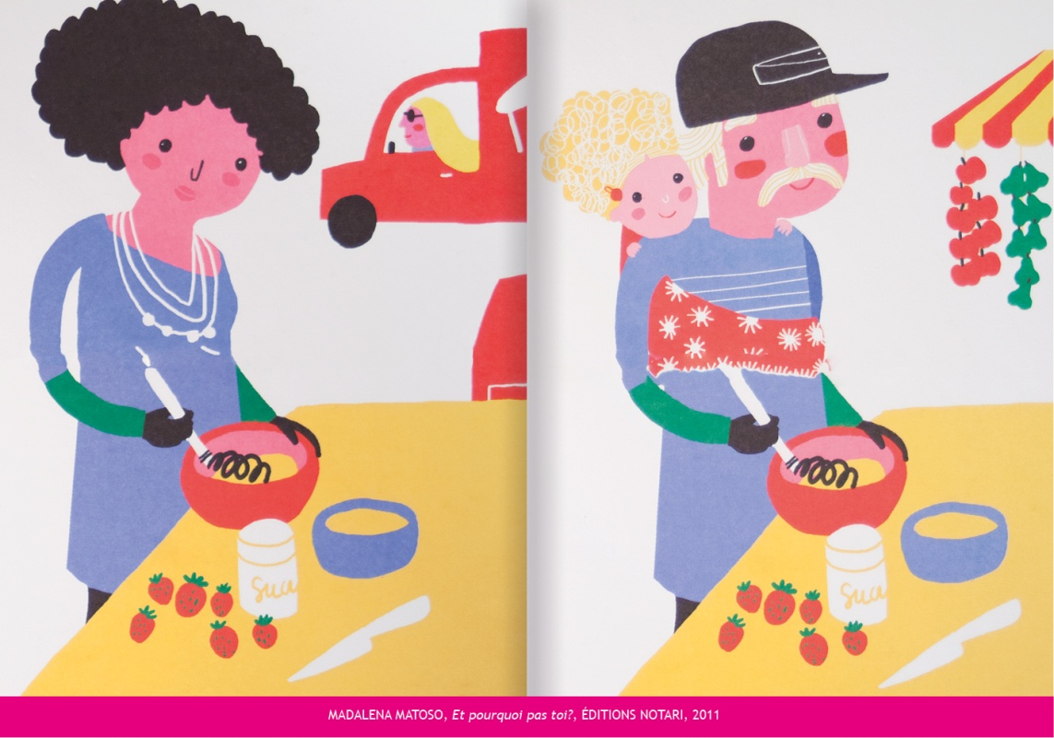
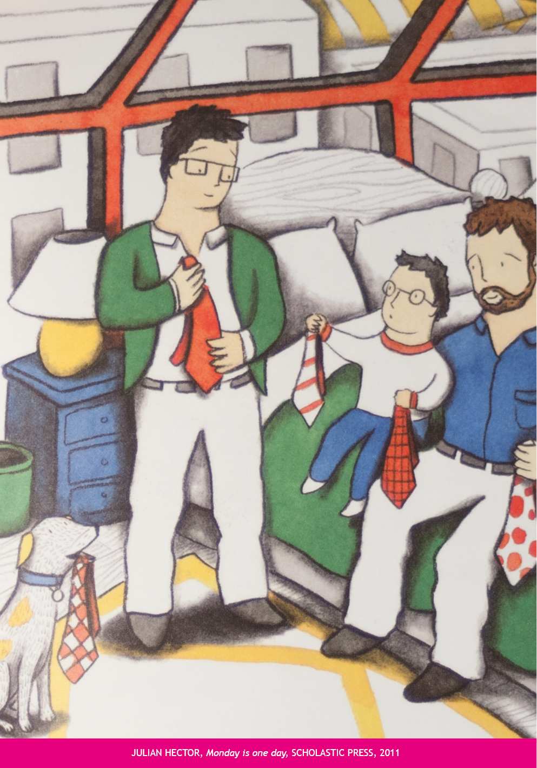
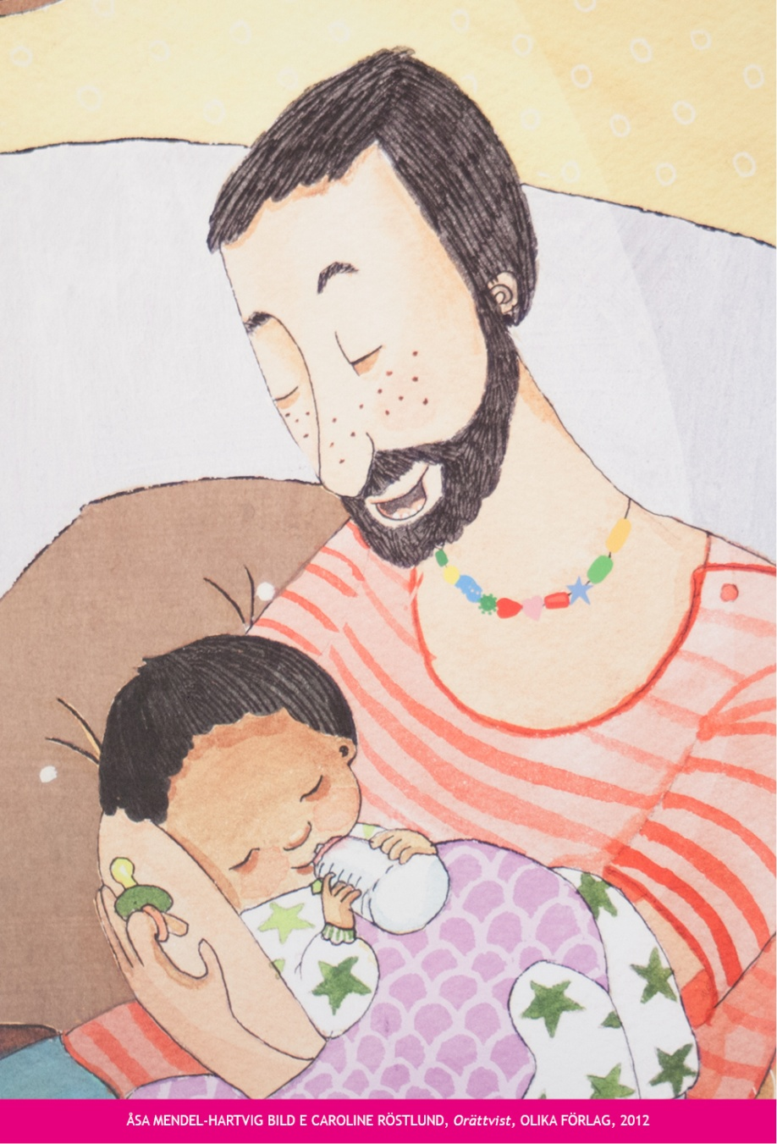
Prejudices related to “what I am” and "what they like" are unconsciously assumed and transmitted by educators and are often also presented in the images and texts of the books that we usually read in classrooms. Over time, these stereotypes create negative factors and influence our children’s professional and personal future choices.
But we can choose another way….

Slide 12
ACCUSATION AND CRITICISM
The Catholic Political Movement “Militia Christi”: your project “teaches sexual education, both theoretical and practical, to children aged 2-6 years, along with an explicit indoctrination against the model of natural family and its roles and parental figures, and the promotion of an homosexual view of the parental couple”.
Gianluigi De Palo, Right party, described our course as “ideological frenzy” in a newspaper.
Don Filippo Morlacchi, Director of the School Department for Catholic Church, invited people to speak up and react against our project, because “School makes a difference – he stated – its aim was to instill ideas in young children in order to produce a cultural change”.

Slide 13
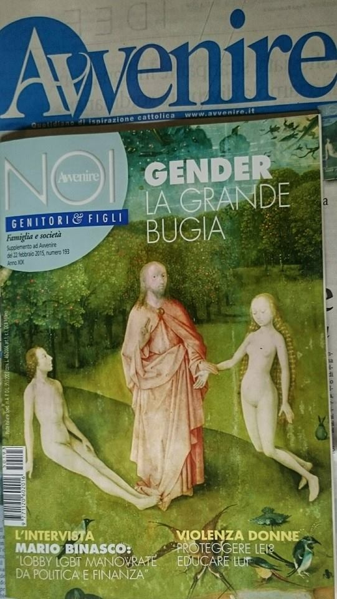
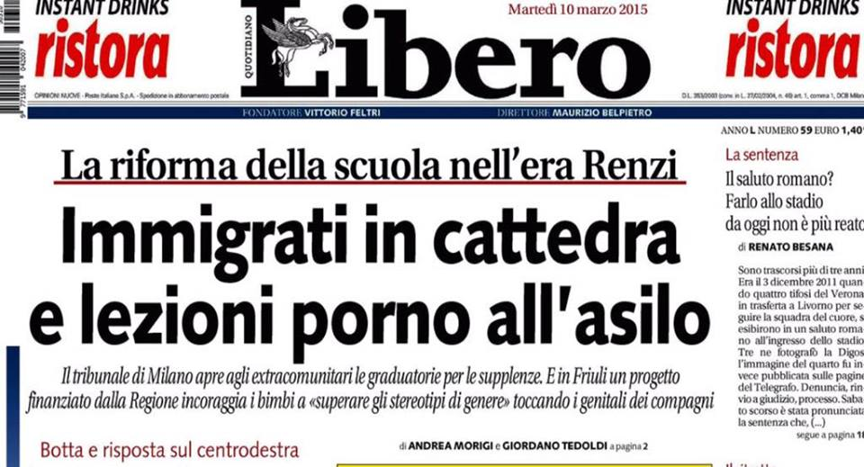
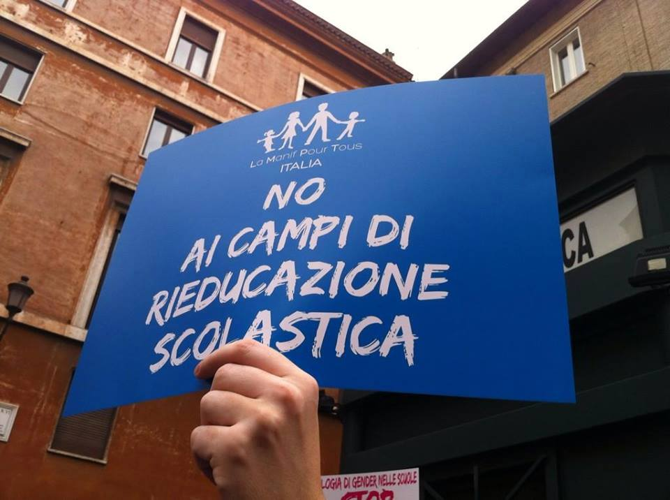
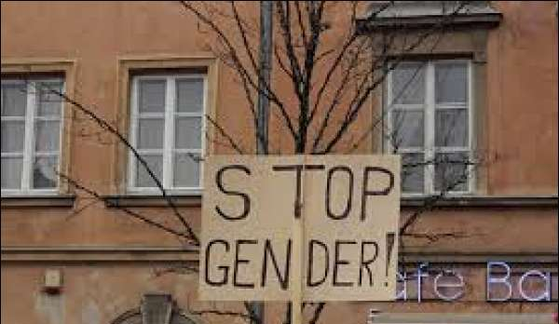

Slide 14
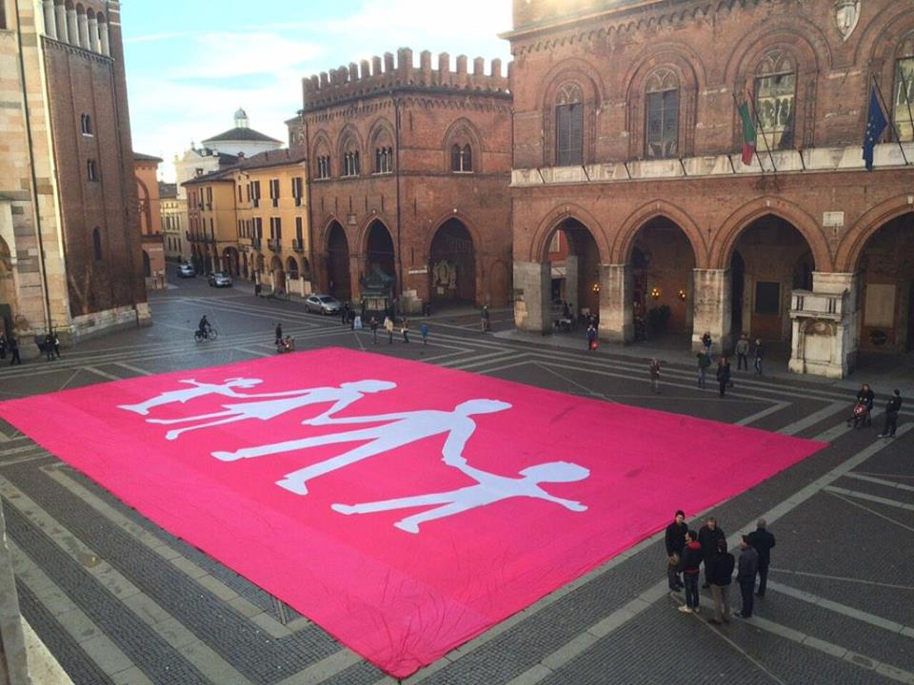
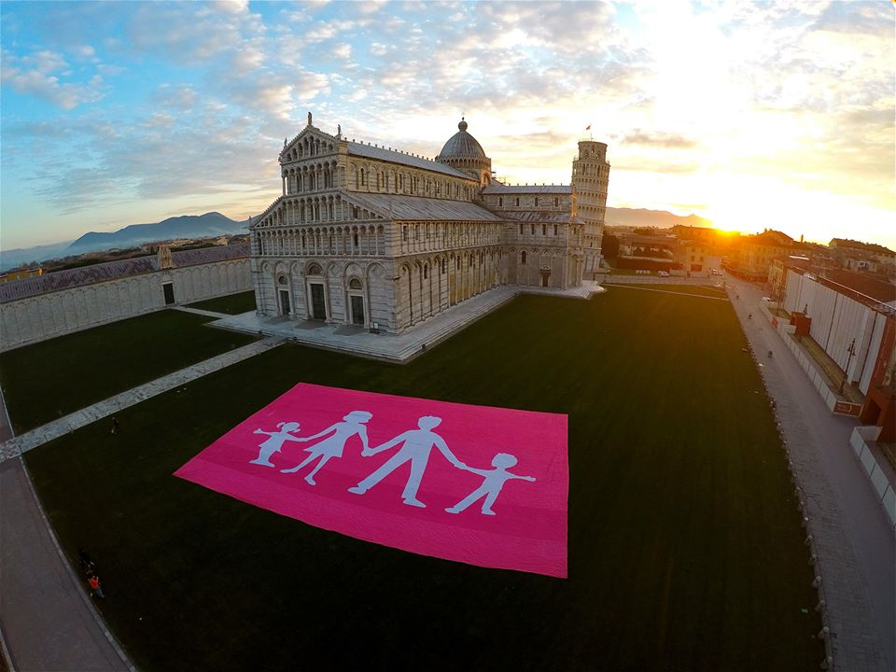
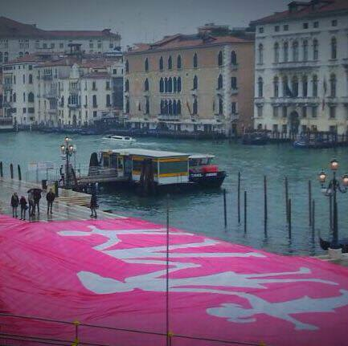
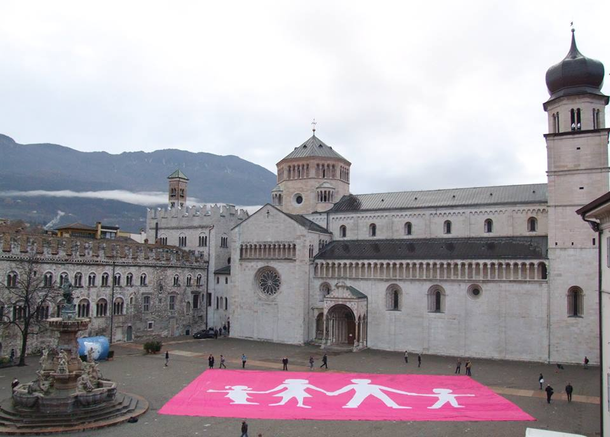
La Manif Pour Tous Italia

Slide 15
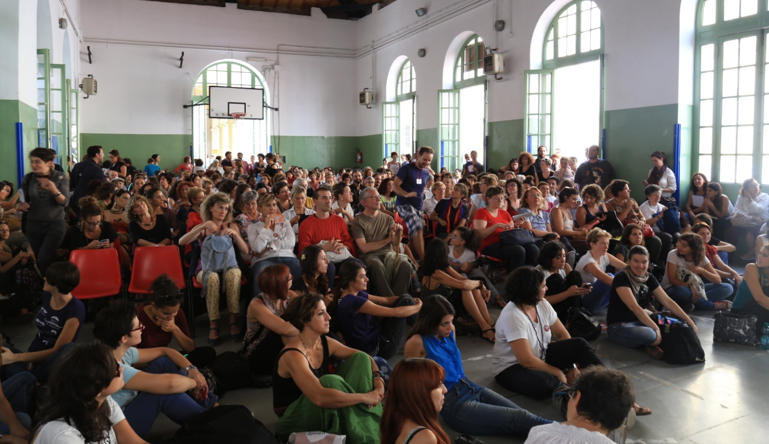
The Italian network
Educare alle differenze,
With 240 organizations in partnership (associations, schools, social services centres, anti-violence centres, women's associations, teachers, educational staff, parents, training consultant, childhood caretakers and community workers, authorities from local governments).
The 2 days meeting in Rome with 600 people,
2 plenary assemblies, 7 roundtables,
a theatre performance, activities for children, exhibitions and stands.

Slide 16
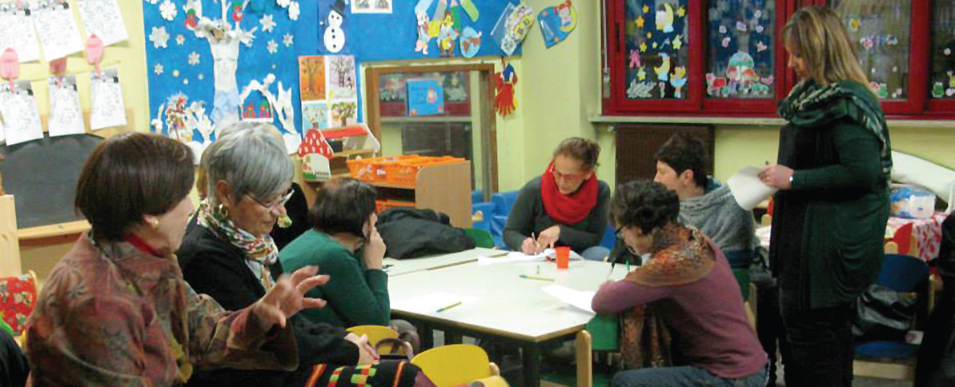
To ensure respects diversity and equality of opportunity in school,
we need to:
promote early learning experiences from early age;
guarantee children protective and gender-sensitive spaces, free them from stereotypes, and ensure their health and well-being;
provide good quality teaching, materials and resources…
….. And a good politics!

Slide 17
…. Thank you!
www.scosse.org
infoscosse@gmail.com

